Slide 1
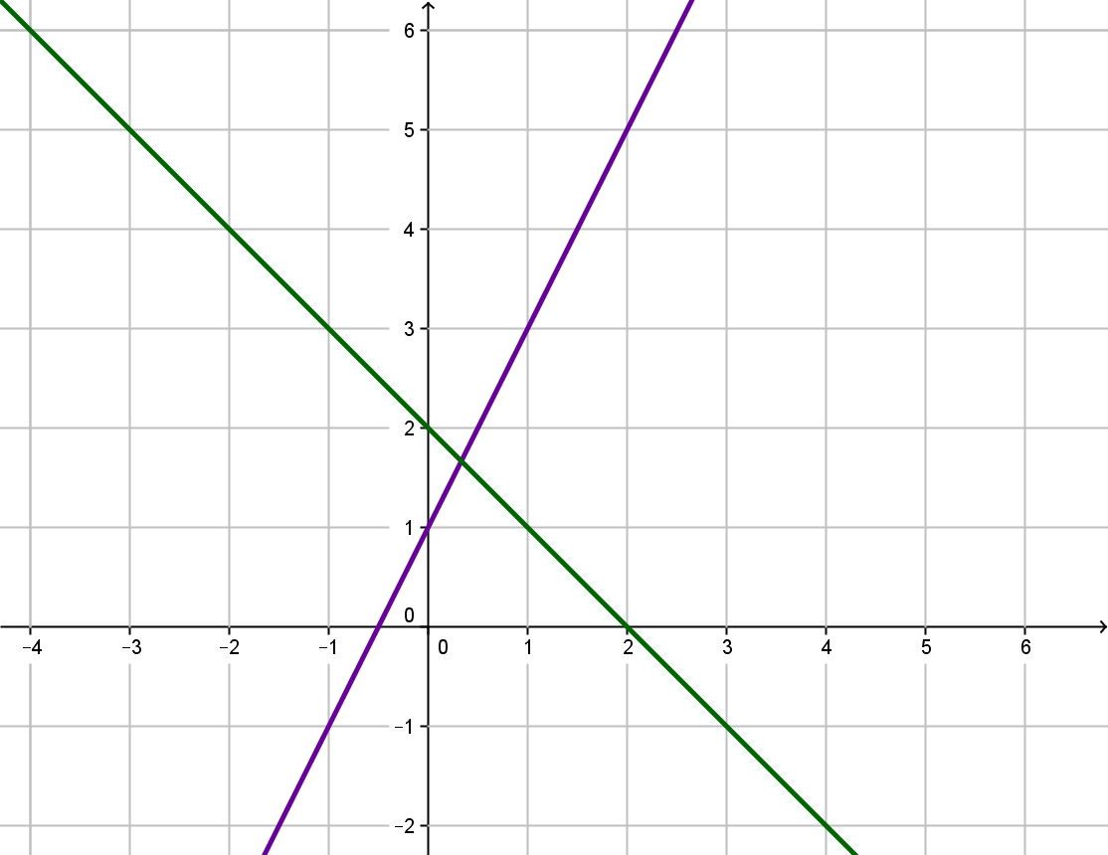
My Percentage Interactive Notebook
Name
Class
Term 4 Semester 2

Slide 2
Contents
Formula Page
Page
Date
Description

Slide 3
Tasks
24
7
30
Essential Question
Questions
Notes
Summary

Slide 4
24
7
30
Date
Percentage
EQ – What is percentage and how do we use it?

Slide 5
1. Changing percentages to fractions
40% =
=
Or you can do it on the calculator
40% =
40 100
Try these
75% =
80% =
Learn these by heart!!
25% =
10% =
50% =
20% =
BIGGER THAN 100%
150% =
BIGGER THAN 1 WHOLE
35% =
MEANS

Slide 6
2. Changing percentages to decimals
Do on calculator as 20 ÷ 100
= 0.2
20% =
0.35% =
0.0035
6% =
0.06
35% =
0.35
87.5% =
0.875
70% =
0.70 or 0.7
175% =
1.75
RULE 2: To change a percentage to a decimal, Divide it by 100.

Slide 7
Summary......
Whenever changing FROM a percentage to a fraction or a decimal, you always DIVIDE it by 100 (put it over 100).

Slide 8
3. Changing fractions to percentages
This is easy – all you have to do is multiply by 100
60%
RULE 3: To change a fraction to a percentage, multiply it by 100.
175%
87½ %
225%

Slide 9
4. Changing decimals to percentages
Another easy one – again we multiply by 100
0.85 =
0.85 × 100 =
85%
0.08 =
0.08 × 100 =
8%
1.75 =
1.75 × 100 =
175%
0.85 =
0.85 × 100 =
85%
0.003 =
0.003 × 100 =
0.3%
RULE 4: To change a decimal to a percentage, multiply it by 100.

Slide 10
Summary......
To change FROM a percentage to a fraction or a decimal, you DIVIDE by 100.
To change INTO a percentage from a fraction or a decimal, you MULTIPLY by 100.

Slide 11
Exercise – copy and complete the table
FRACTION
DECIMAL
PERCENT
¾
0.75
75%
¹⁸/₂₅
0.72
72%
2/5
0.4
40%
1³/₅
1.6
160%
⁷/₁₀
0.7
70%
5 ½
5.5
550%
¹/₁₂₅
0.008
0.8%
²/₃
%
9/13
2 ⁹/₁₀
2.9
290%

Slide 12
×
Finding percentages of quantities
Example 1: Find 85% of $300
300
=
$255

Slide 13
Finding percentages of quantities
Example 3: Find 5 % of 3 metres
Good idea to change to cm, as our answer will be only a small amount!
×
300 cm
=
15 cm
If we didn’t change to cm, then our answer would be 0.15 metres, which is also correct.

Slide 14
Expressing one quantity as a percentage of another quantity
Example 1: Express $80 as a percentage of $400.
Write as a fraction then multiply by 100 to change it into a percentage.
×
100
=
20%

Slide 15
Questions
Exercise 16.6 & 16.7
Page 219

Slide 16
Notes Review
24, 7 ,30
Date
Title
Essential question
Notes complete
Notes complete with colour and diagrams
Questions completed
Contents page filed in
Formula page filled in

Slide 17
Homework
Review your notes and write a summary answering the essential question.

